Slide 1
Topic 11: The Presidency
Executive institutions and politics

Slide 2
A Puzzle
Why did the power of presidents increase substantially in the 20th century only to encounter substantial and consequential push-back from Congress and the Courts?
Have presidents increased their power at the expense of the legislative and judicial branches?
What are the consequences of shifts in institutional power?
Notes:
Recall that the Founders feared a strong central executive. As the text notes, however, the unitary president faces no collective action problems, which has helped presidents consolidate power.
Presidents are now seen as more powerful than in the early decades of the United States. That power increases their ability to serve as leaders and to influence public policy. At the same time, with that increased power and prestige, modern presidents receive disproportionate blame for economic problems, domestic policy failures, and foreign policy problems.

Slide 3
The Presidency and the Founding
The Framers of the Constitution were ambivalent about executive power.
1. The colonial experience with the King of England and royally appointed governors warned Americans of the dangers of strong executives.
2. The weak executive under the Articles of Confederation highlighted the problems of governing without a potent executive.

Slide 4
Led by Alexander Hamilton, Federalists sought to provide for a presidency that was:
energetic;
independent of Congress;
endowed with sufficient powers to lead.

Slide 5
II. Cooperation through collective bargaining is difficult and the difficulty mounts as the number of people grows.
Federalists valued “unity” in the executive so that presidents would be decisive and could act quickly.

Slide 6
Constitutional Bases of Presidential Power
The Founders and the unitary executive
Respond decisively to crises
Enforce laws uniformly and fairly
Coerce conflicting groups to cooperate
Notes:
Federalists argued that the country needed a strong executive who would respond decisively to crises (domestic and foreign) and enforce the laws uniformly and fairly.

Slide 7
Unity was designed to imbue the presidency with the reverse of a collective action problem.
“That unity is conducive to energy will not be disputed. Decision, activity, secrecy, and dispatch will generally characterize the proceedings of one man in a much more eminent degree than the proceedings of any greater number; and in proportion as the number is increased, these qualities will be diminished.”
-- Alexander Hamilton, Federalist #70

Slide 8
Although they sought an energetic presidency, their ambivalence toward executive power led the Framers of the Constitution to remove the president from direct popular control.
The four-year presidential term was designed to calibrate this leeway and popular control.
The Electoral College also stood as an important barrier to popular control of the President.

Slide 9
“The republican principle demands that the deliberate sense of the community should govern the conduct of those to whom they entrust the management of their affairs; but it does not require an unqualified complaisance to every sudden breeze of passion or to every transient impulse … it is the duty of the persons whom they have appointed … to withstand the temporary delusion.”
--Alexander Hamilton, Federalist #71

Slide 10
Electoral College
“Faithless electors” are rare – the electoral college does not exercise independent judgment.
Absolute majority of votes in the "electoral college."
That is, 538/2=269 + 1= 270 votes.
Each state has a number of votes equal to its membership in the House and Senate, e.g. TN 9+2; CA 53+2; WY: 1+2.
Most states allocate their electoral votes as a bloc to the winner of a plurality of popular votes in their state.
In 2004 VA had a result of 54% Bush, 46% Kerry, so Bush got all 13 votes.
In 2008, 2012, and 2016 Democratic candidates won more votes than the Republican candidate, and won all of Virginia’s electoral votes

Slide 11
Why the Electoral College Sometimes Chooses the Less Popular Candidate
In 2016, the vote for Trump was distributed more efficiently than Clinton’s vote. Suppose there were just five states.
In the example above, Clinton has a majority of the popular vote (14 of 25 votes), but looses in the electoral college.
TTTCC | TTTCC | TTTCC | TTCCC | CCCCC

Slide 12
Sources of Presidential Power
Expressed powers – explicitly stated in the constitution. (e.g. veto power, power to take care that the laws be faithfully executed.)
Delegated powers – Constitutional powers assigned to one agency (e.g. the Congress) but exercised by another (e.g. the President) with the express permission of the first. (e.g. pollution regulation).
Inherent powers – powers claimed by a president that are not expressed in the Constitution, but are inferred from it. (e.g. executive privilege).

Slide 13
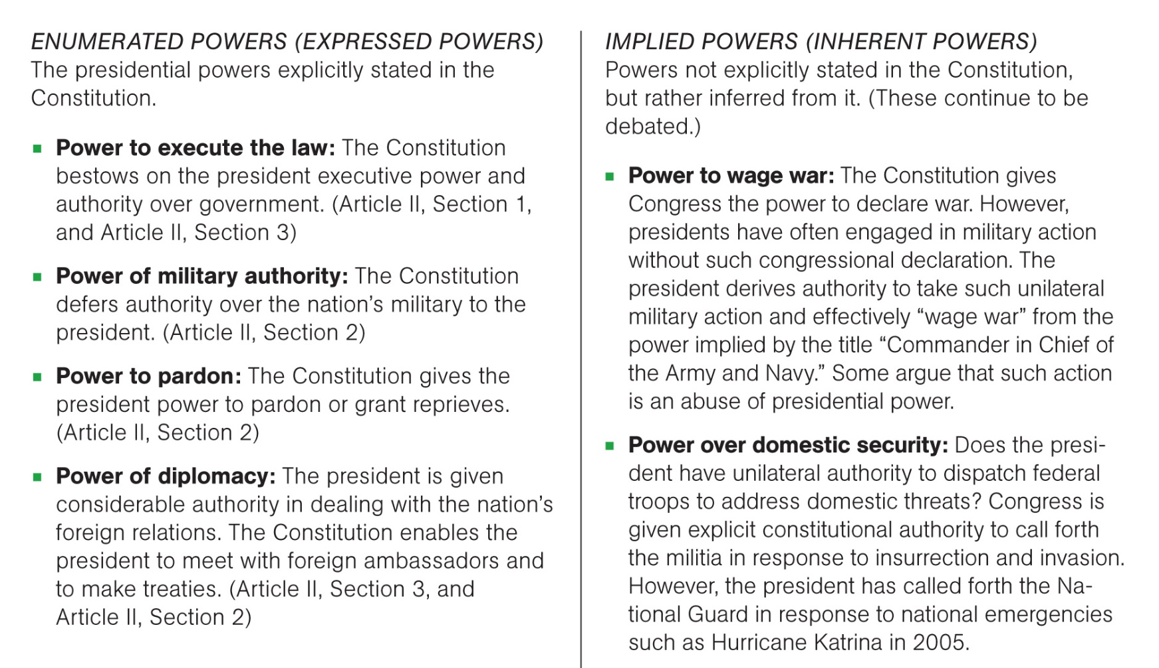
Constitutional Bases of Presidential Power
Notes:
Constitutional Powers of the Presidency

Slide 14
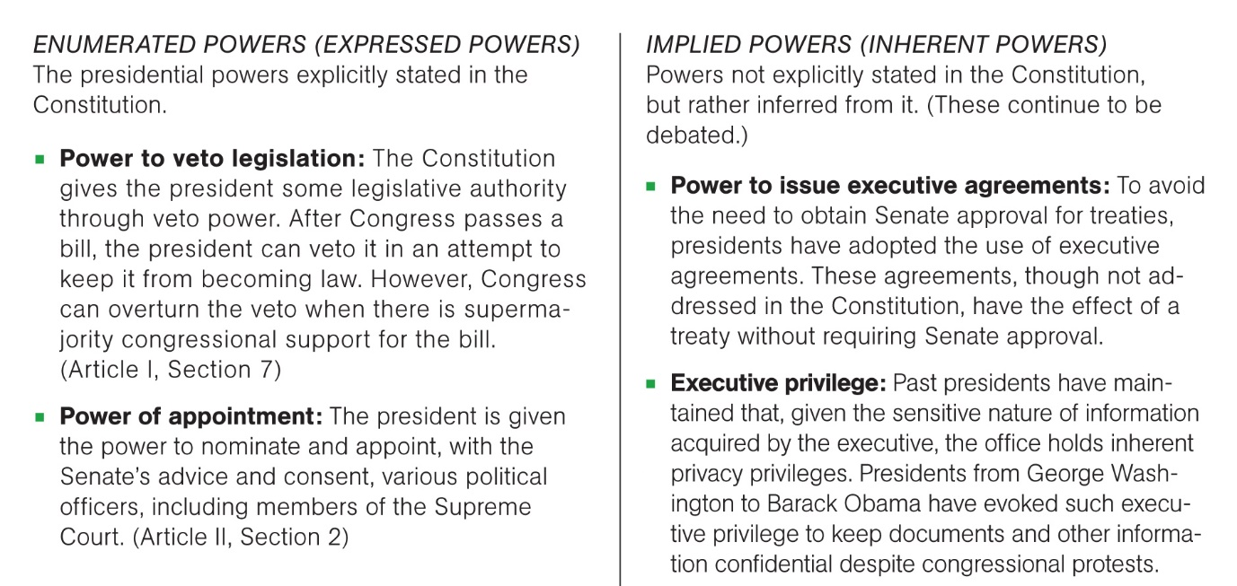
Constitutional Bases of Presidential Power
Notes:
Constitutional Powers of the Presidency

Slide 15
Review
Unitary Executive
Expressed, delegated, and inherent powers.
Chosen through electoral college.

Slide 16
The President and Congress: Veto Power
Article 1, Section 7: President can veto legislation passed by Congress, although Congress can overturn veto with 2/3 majorities in both House and Senate.
Veto used 1448 times from 1789-1992, with 104 successful overrides. Also 1067 pocket vetoes.
President and the political ‘agenda’

Slide 17
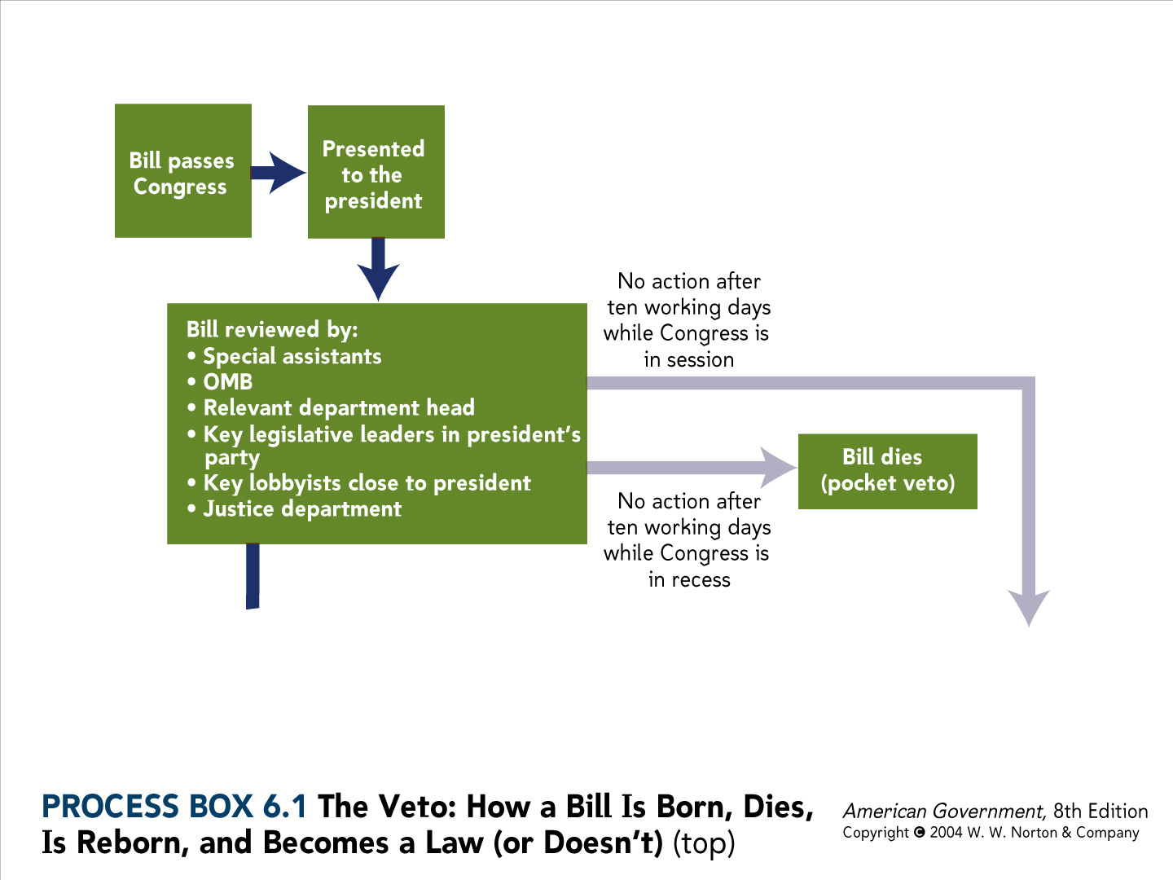
Process Box 6.1 top

Slide 18
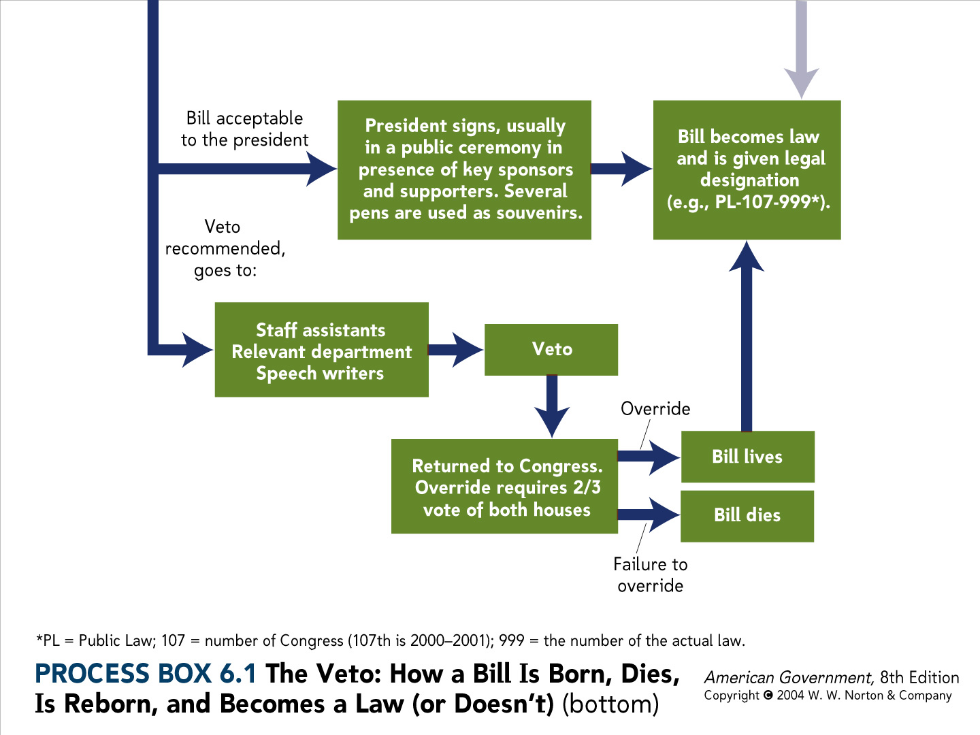
Process Box 6.1 bottom

Slide 19
Veto Power and its limits
2/3 of Members
1/3 of Members
C
V
P
Veto pivot
Position of Congressional Median
President’s Position
President can only sustain a veto on policy when supported
by more than 1/3 of at least one chamber:
by V and all members to the right of V

Slide 20
Veto Power Game
The goal – create a minimum wage policy that benefits your team the most.
Each team represents one of seven legislators deciding on the minimum wage.
Points will be given based on how close the final policy is to your team’s ideal wage.
Order of Play
Status quo is set
Legislature selects policy (President may issue veto threats)
P president chooses whether to veto
Legislature attempts to override veto

Slide 21
Points Received for each Possible Minimum Wage
 | $7 | $7.5 | $8 | $8.5 | $9 | $9.5 | $10
Team 1 | 7 | 6 | 5 | 4 | 3 | 2 | 1
Team 2 | 6 | 7 | 6 | 5 | 4 | 3 | 2
Team 3 | 5 | 6 | 7 | 6 | 5 | 4 | 3
Team 4 | 4 | 5 | 6 | 7 | 6 | 5 | 4
Team 5 | 3 | 4 | 5 | 6 | 7 | 6 | 5
Team 6 | 2 | 3 | 4 | 5 | 6 | 7 | 6
Team 7 | 1 | 2 | 3 | 4 | 5 | 6 | 7
President | 2 | 3 | 4 | 5 | 6 | 7 | 6
SQ 2
SQ 4
SQ 1
SQ 3
Notes:
I can sustain the veto for sq 3, thereby preventing the majority from getting what it prefers. Sq 4, they don’t have to be strategic to get something through – we agree. Sq 1 there is a bargain to be struck. Can I leverage my veto power to persuade them to adopt more than 8.5. SQ 2 – veto doesn’t matter because there is no majority support for any bill to change policy.

Slide 22
Implications of Game
The veto matters… but
Presidential influence depends upon
Bargaining strategies (e.g. effective use of threats)
The degree to which the President and Congress disagree
Which is influenced by the status quo.
An application – why did Bush veto only once before 2007, and more after that?
Partisan control of Congress

Slide 23
Presidential Vetoes
Notes:
Source: John T. Woolley and Gerhard Peters, eds., The American Presidency Projects (Santa Barbara, CA: University of California, 1999–2010), www.presidency.ucsb.edu/data/vetoes.php .

Slide 24
Expanding Presidential Power
Presidential power expanded greatly from the 19th century to the 20th century as presidents both strengthened their connections to the people and expanded their institutional power.
Congress responded in a variety of ways, aiming to maintain influence while delegating some powers to the president.

Slide 25
In the 20th Century, presidents expanded their connections to the people due to:
The advent of popular presidential campaigning;
The use of conventions and then primary election;

Slide 26
Also in the 20th century, changing conceptions of the importance of the President led to an increase in presidential power:
The president plays a more direct role in setting the domestic policy agenda;
Presidents often attempt to use popular support to pressure Congress by ‘going public’.
The immediacy of modern war making and America’s role in the world expanded presidential strength.

Slide 27
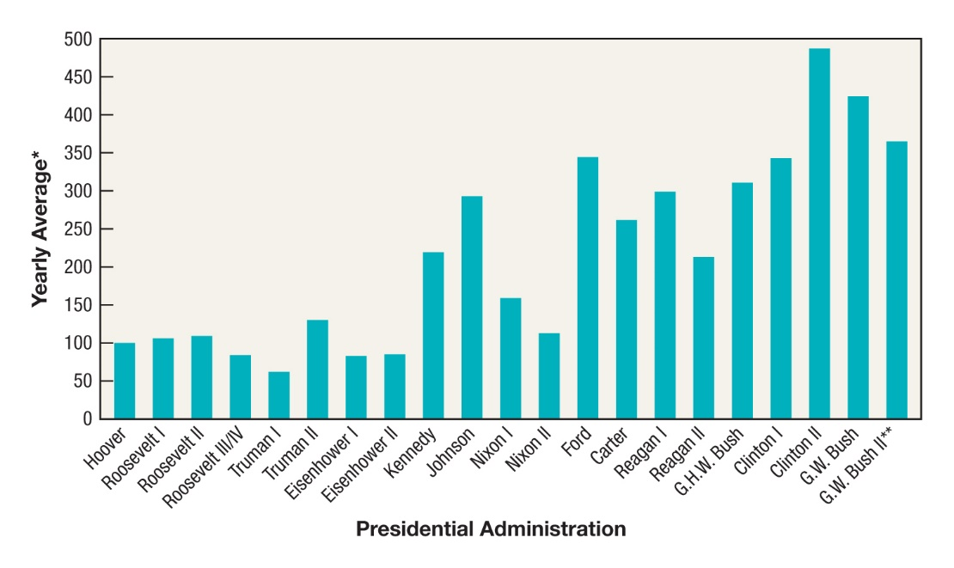
Presidential Public Activities
Notes:
*The yearly average number of public activities by presidents, including major speeches, news conferences, minor speeches,
and U.S. appearances, including those in Washington D.C. Excluded are specifically political activities.
**Through 2007 only.
Fig 6.1 Presidential Public Activities in the United States
Source: Lyn Ragsdale, Vital Statistics on the Presidency, 3rd ed. (Washington, DC: Congressional Quarterly Press, 2009), p. 207.

Slide 28
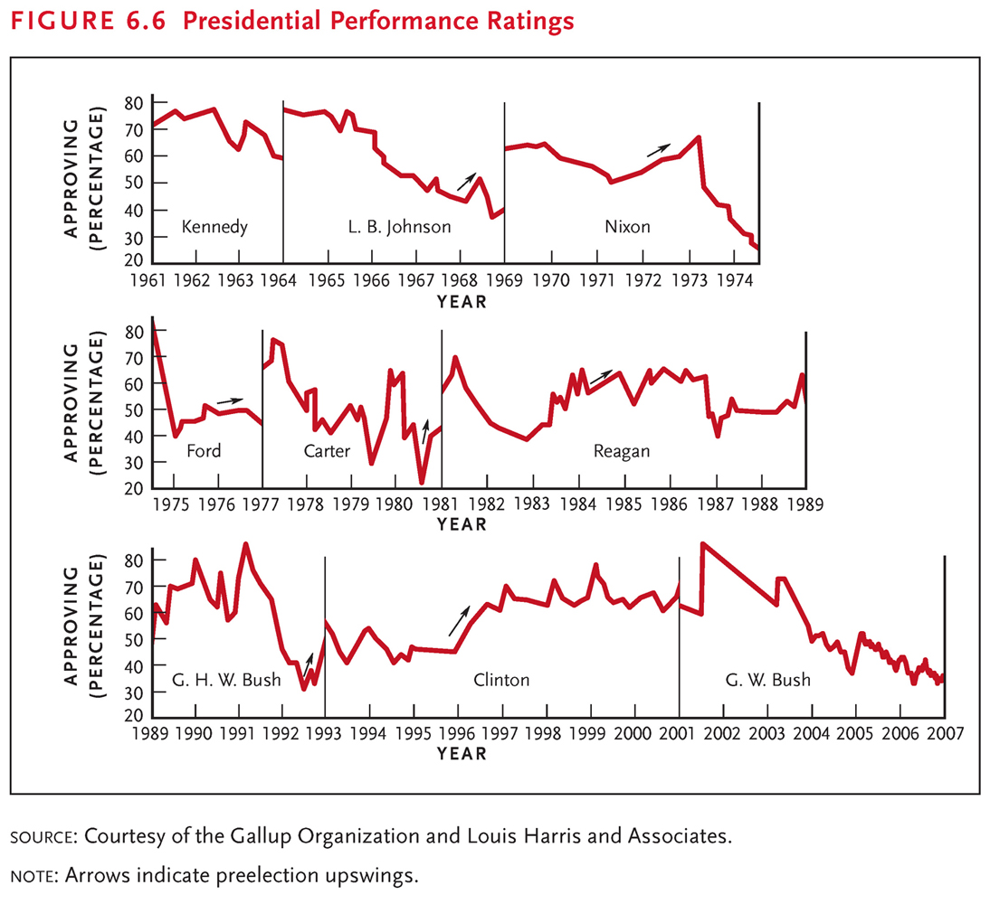

Slide 29
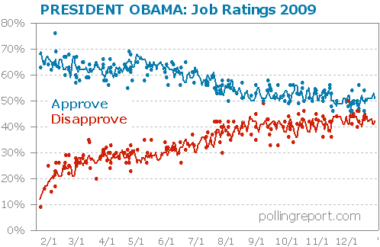
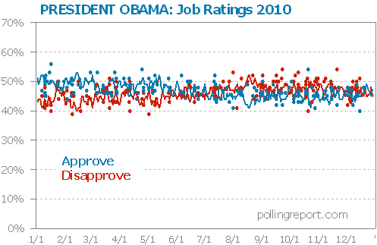
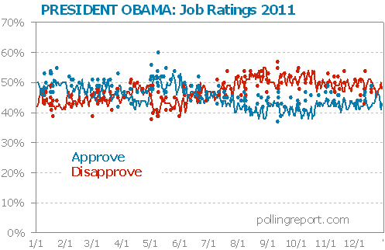
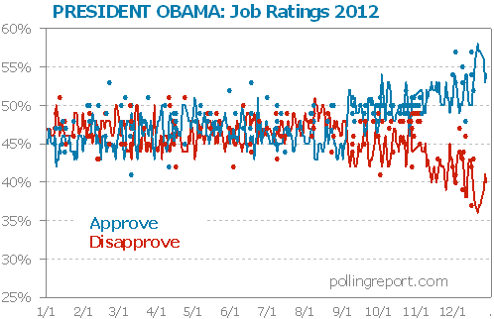

Slide 30
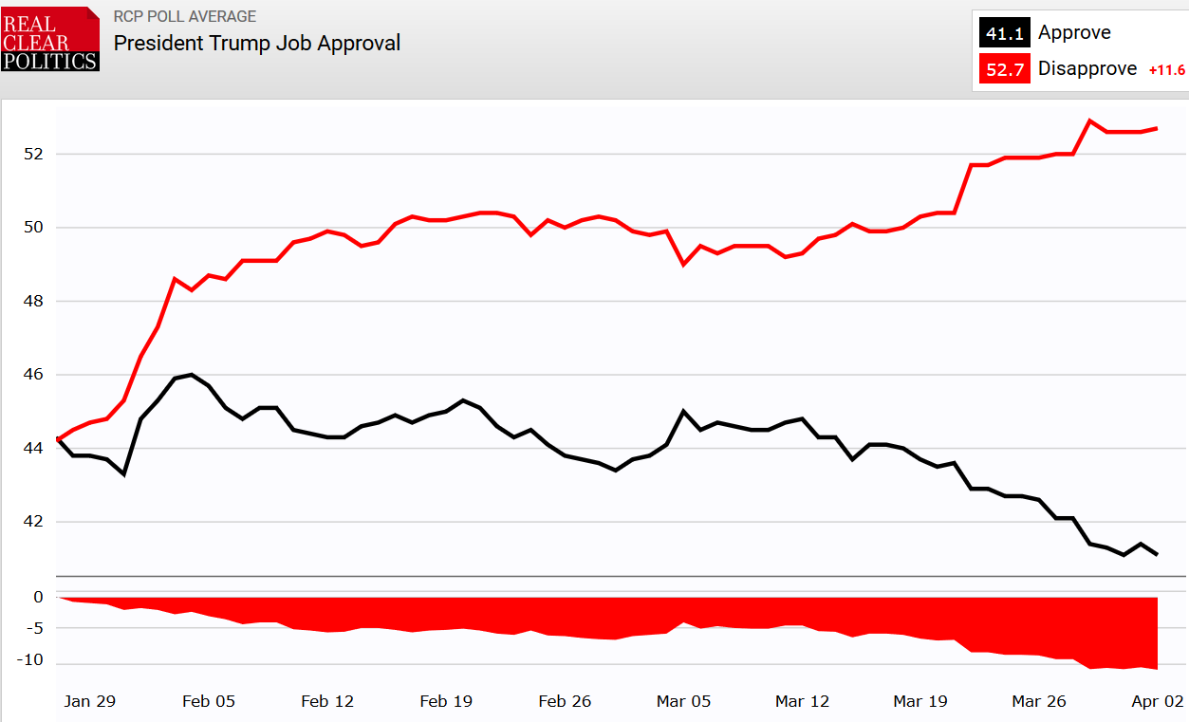

Slide 31
Institutional Changes Enhanced Presidential Power
Expanding White House Staff
White House Staff increased from one or two clerks in the 19th century to fewer than 50 in the 1930s to over 500 in contemporary White Houses.
Organizational elaboration within the White House increased specialization and expertise in Presidency.

Slide 32
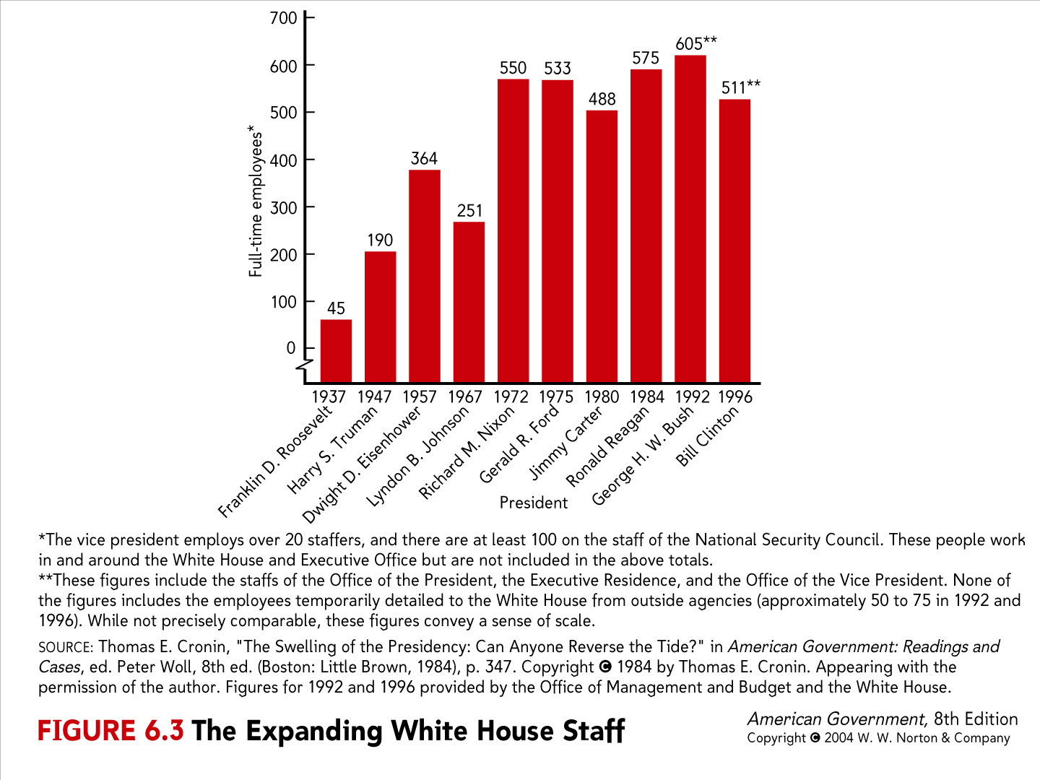
Fig. 6.3
Notes:
Obama White House staff in 2012 – 468 https://obamawhitehouse.archives.gov/briefing-room/disclosures/annual-records/2012

Slide 33
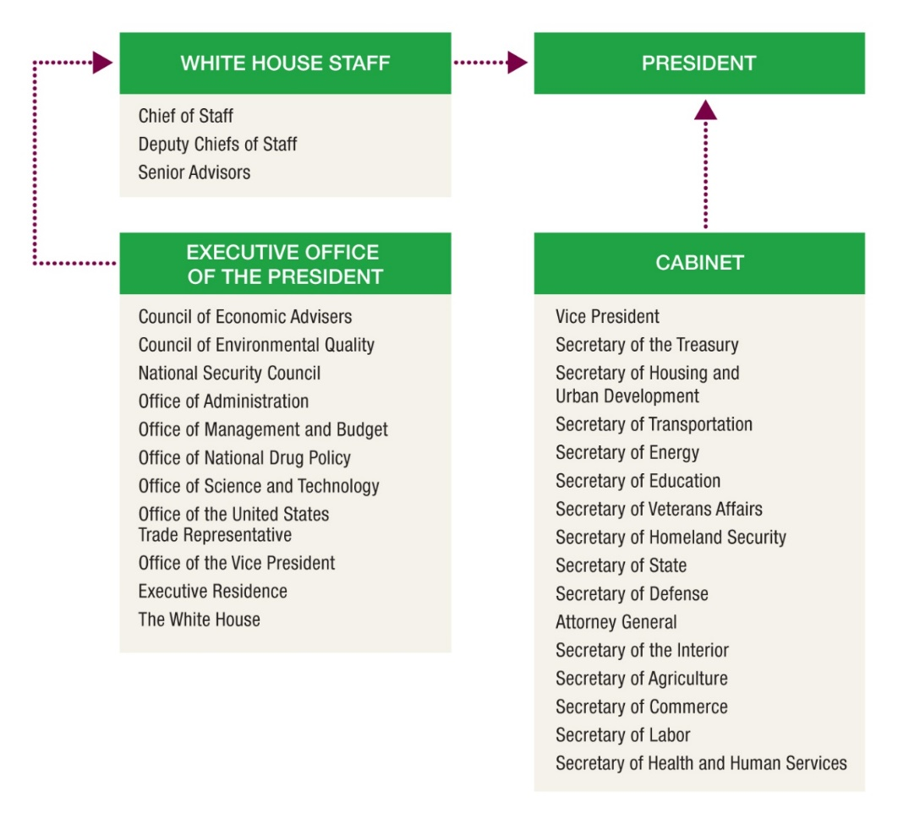
Bureaucratic Institutions in the Obama Administration
Notes:
While these institutions are standard for the executive branches today, none of these existed before FDR took office.
Fig. 6.2 The Modern Presidency: Bureaucratic Institutions in the Obama Administration

Slide 34
Powers of Unilateral Action
Institutional Changes Enhanced Presidential Power
Expanding Executive Branch
Growing Executive Administration empowers the President as the “Chief Executive.”
Presidents use appointment powers, executive reorganization, and executive orders to affect policy through executive action.

Slide 35
Notes:
Fig. 6.4 Signing Statement on Constitutional Interpretation
Source: Lyn Ragsdale, Vital Statistics on the Presidency, 3rd ed. (Washington, DC: Congressional Quarterly Press, 2009), pp. 460–62.

Slide 36
Executive Order Success Rate
From 1973-1997, Presidents issued about 1,000 executive orders.
Congress only tried to overturn 37 of them.
Only 3 of 37 became law.
Seemingly presidents act unilaterally when they think they are within the range of where they could issue a sustainable veto of a Congressional effort to override their action.

Slide 37
Treaties versus Executive Agreements
Treaties
Executive agreements
1789-1839
60
27
Reagan
125
2,840
Bush
67
1,350
Clinton (through 1996)
97
1,137

Slide 38
Other Sources of Unilateral Power
Recess Appointments
When Congress is out of session the president can temporarily fill vacant offices including judicial offices without congressional consent.
Increasingly used by presidents.
But in the 110th Congress the Senate responded by not going into recess.

Slide 39
Other Sources of unilateral powers
Signing Statements
While signing a bill, President asserts that a portion of a bill is not constitutional and will not be enforced.
Increase scrutiny by Congress.
Diminished use by Bush after 2006.

Slide 40
Unilateral War Powers?
Use of US Forces Abroad
1798-1900: 106
1901-1994: 133

Slide 41
Presidents, Congress, and War
Article I, section 8: Congress shall have the power to declare war.
But Article 2, section 2: The President is Commander in Chief.
Charles Pinckney at the constitutional convention said that giving the President exclusive war power “would render the Executive a Monarchy of the worst kind.”
Only 5 declarations of war: 1812, 1846, 1898, 1917, 1941 relative to >239 largely unilateral military actions
Other wars: Korea, Vietnam, Gulf, Afghanistan, Iraq

Slide 42
Congressional War Power
Congress has power to declare war, and power of purse… but most military actions have not required a Congressional declaration.
War Power Act attempted to assert Congressional control by requiring notification, and Congressional assent.

Slide 43
The Skills of Individual Presidents
Individual Presidents have expanded the power of the office through their own personal skills.
Franklin D. Roosevelt’s confident leadership during the crises of the Great Depression and World War II helped create the modern presidency.
Lyndon B. Johnson’s experience as a legislative leader made him one of the most successful presidents in terms of leading Congress.

Slide 44
Ronald Reagan’s communications skills, honed as a Hollywood actor, solidified his political strength through effective use of television to lead the nation and to pressure other political elites.

Slide 45
Principle of Politics #5: History matters.
Historical processes shape institutions.
History provides a normative context by which we can understand and interpret political events and outcomes.
FDR, LBJ, and Ronald Reagan not only shaped the institution of the presidency but they are also historical markers by which other presidents will be judged.

Slide 46
The Framers’ ambivalence toward executive power has created a “gray area” in which the strength of the presidency is primarily determined by the individual skills of presidents and the support of the public.

Slide 47
Presidents on the Presidency
“Being President is like riding a tiger. A man has to keep on riding or be swallowed.” - Harry S. Truman
“The president is at liberty, both in law and conscience, to be as big a man as he can.” - Woodrow Wilson
“Sometimes I wish I could be President and Congress too.” - Theodore Roosevelt

